Slide 1
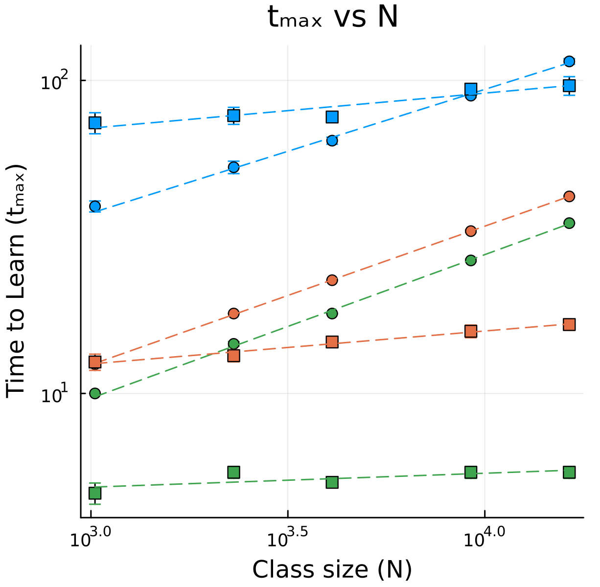
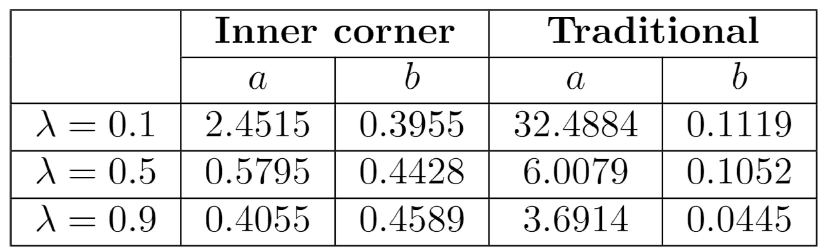
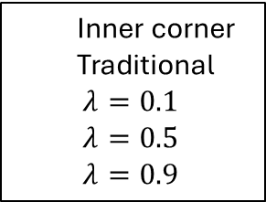
T(0.1)
Inner corner
Traditional
$λ=0.1$
$λ=0.5$
$λ=0.9$
I(0.1)
I(0.5)
I(0.9)
T(0.5)
T(0.9)

Slide 2
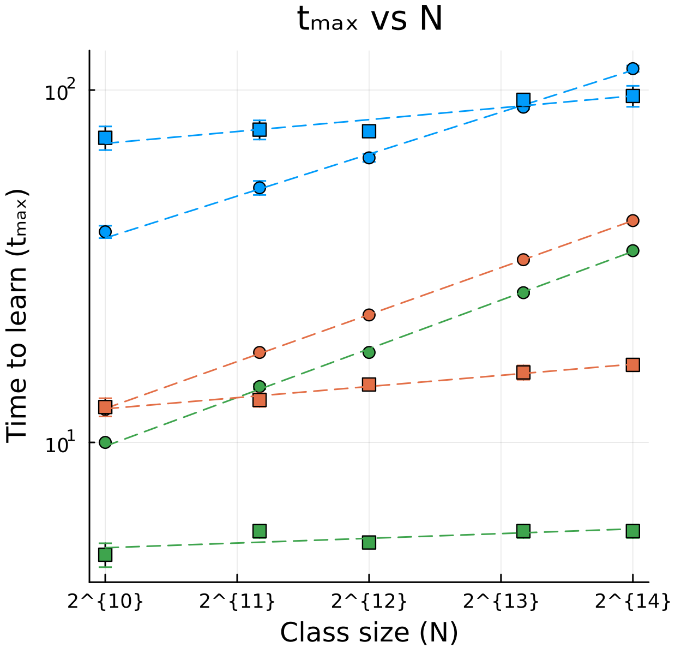

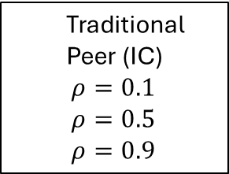





Traditional $(ρ_{0}=0.1)$
Traditional
Peer (IC)
$ρ=0.1$
$ρ=0.5$
$ρ=0.9$
Peer $(ρ_{0}=0.1)$
Peer $(ρ_{0}=0.5)$
Peer $(ρ_{0}=0.9)$
Traditional $(ρ_{0}=0.5)$
Traditional $(ρ_{0}=0.9)$

Slide 3



Inner corner
Center
Outer corner
$$d_{max}=\frac{L\sqrt{2}}{4}$$
$$d_{max}=\frac{L\sqrt{2}}{2}$$
$$d_{max}=\frac{L\sqrt{2}}{2}$$

Slide 4
Inner corner
Center
Outer corner
Random

Slide 5
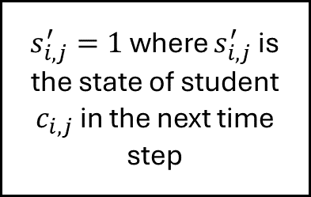
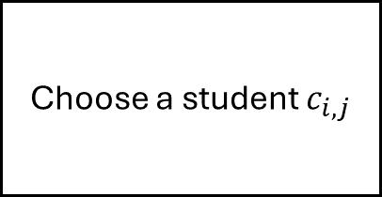
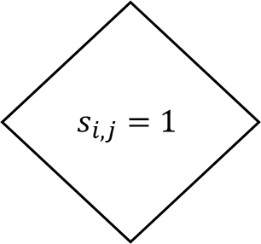
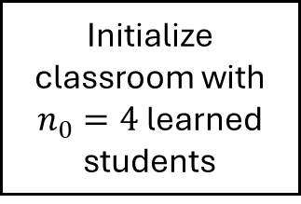
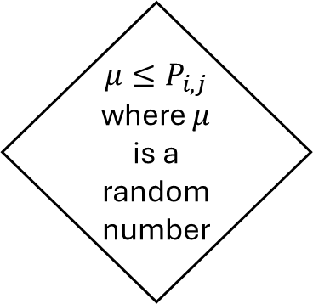
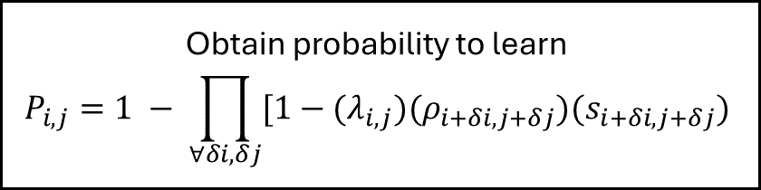
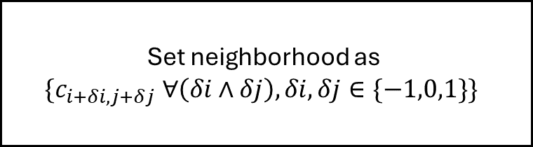
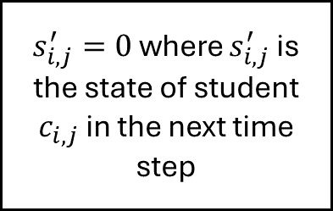
$$s_{i,j}=1$$
Initialize classroom with $n_{0}=4$ learned students
Choose a student $c_{i,j}$
Set neighborhood as
$$\{c_{i+δi,j+δj} ∀\left(δi∧δj\right), δi, δj∈\{−1,0,1\}\}$$
False
True
Obtain probability to learn
$$P_{i,j}=1 − \prod_{∀δi, δj}{[1−(λ_{i,j})(ρ_{i+δi, j+δj})(s_{i+δi, j+δj})}$$
$μ≤P_{i,j}$ where $μ$ is a random number
$s_{i,j}^{′}=0$ where $s_{i,j}^{′}$ is the state of student $c_{i,j}$ in the next time step
$s_{i,j}^{′}=1$ where $s_{i,j}^{′}$ is the state of student $c_{i,j}$ in the next time step
True
False

Slide 6


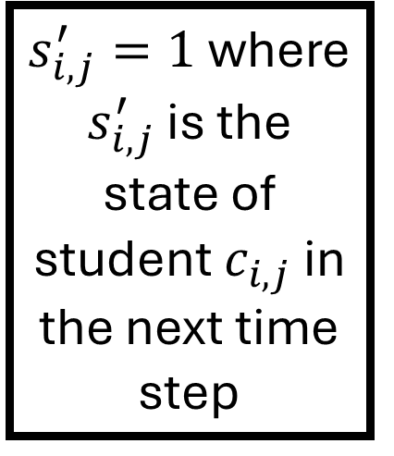
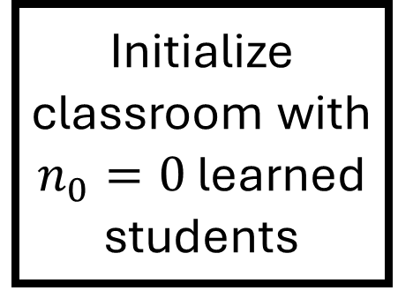


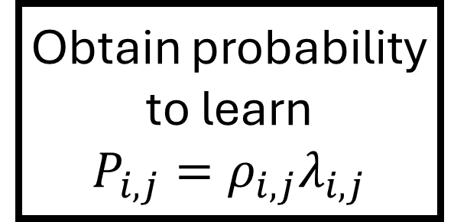

Initialize classroom with $n_{0}=0$ learned students
$$s_{i,j}=1$$
Obtain probability to learn
$$P_{i,j}=ρ_{i,j}λ_{i,j}$$
Begin
Choose a student $c_{i,j}$
False
False
False
Steady state achieved
Done for all $i,j$
End
True
True
True
$μ≤P_{i,j}$ where $μ$ is a random number
$s_{i,j}^{′}=1$ where $s_{i,j}^{′}$ is the state of student $c_{i,j}$ in the next time step
$s_{i,j}^{′}=0$ where $s_{i,j}^{′}$ is the state of student $c_{i,j}$ in the next time step
True
False
One time step

Slide 7
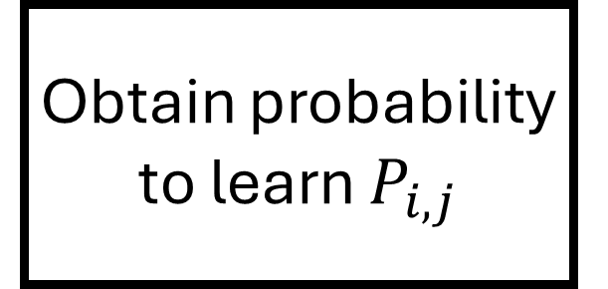
Initialize classroom with $n_{0}=0$ learned students
$$s_{i,j}=1$$
Obtain probability to learn $P_{i,j}$
Begin
Choose a student $c_{i,j}$
False
False
False
Steady state achieved
Done for all $i,j$
End
True
True
True
$μ≤P_{i,j}$ where $μ$ is a random number
$s_{i,j}^{′}=1$ where $s_{i,j}^{′}$ is the state of student $c_{i,j}$ in the next time step
$s_{i,j}^{′}=0$ where $s_{i,j}^{′}$ is the state of student $c_{i,j}$ in the next time step
True
False
One time step

Slide 8



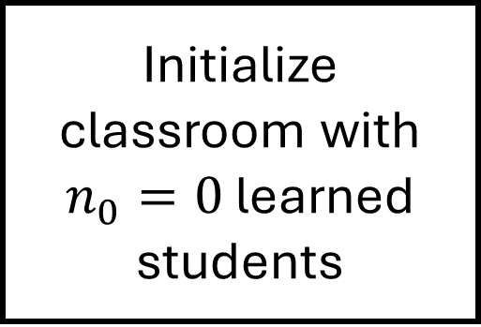


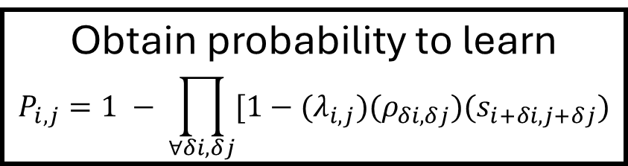

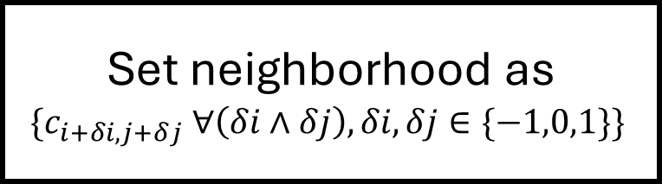
Initialize classroom with $n_{0}=0$ learned students
$$s_{i,j}=1$$
Begin
Choose a student $c_{i,j}$
Set neighborhood as
$$\{c_{i+δi,j+δj} ∀\left(δi∧δj\right), δi, δj∈\{−1,0,1\}\}$$
False
False
False
Steady state achieved
Done for all $i,j$
Obtain probability to learn
$$P_{i,j}=1 − \prod_{∀δi, δj}{[1−(λ_{i,j})(ρ_{δi, δj})(s_{i+δi, j+δj})}$$
End
True
True
True
$s_{i,j}^{′}=0$ where $s_{i,j}^{′}$ is the state of student $c_{i,j}$ in the next time step
$s_{i,j}^{′}=1$ where $s_{i,j}^{′}$ is the state of student $c_{i,j}$ in the next time step
$μ≤P_{i,j}$ where $μ$ is a random number
True
False
One time step

Slide 9
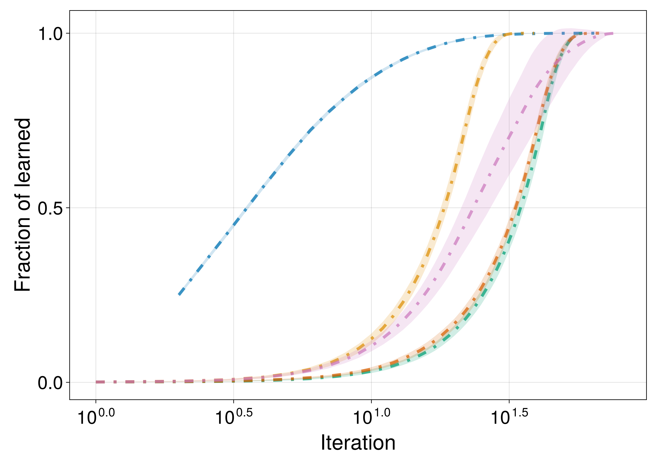
Random
Inner Corner
Center
Traditional
Outer Corner

Slide 10
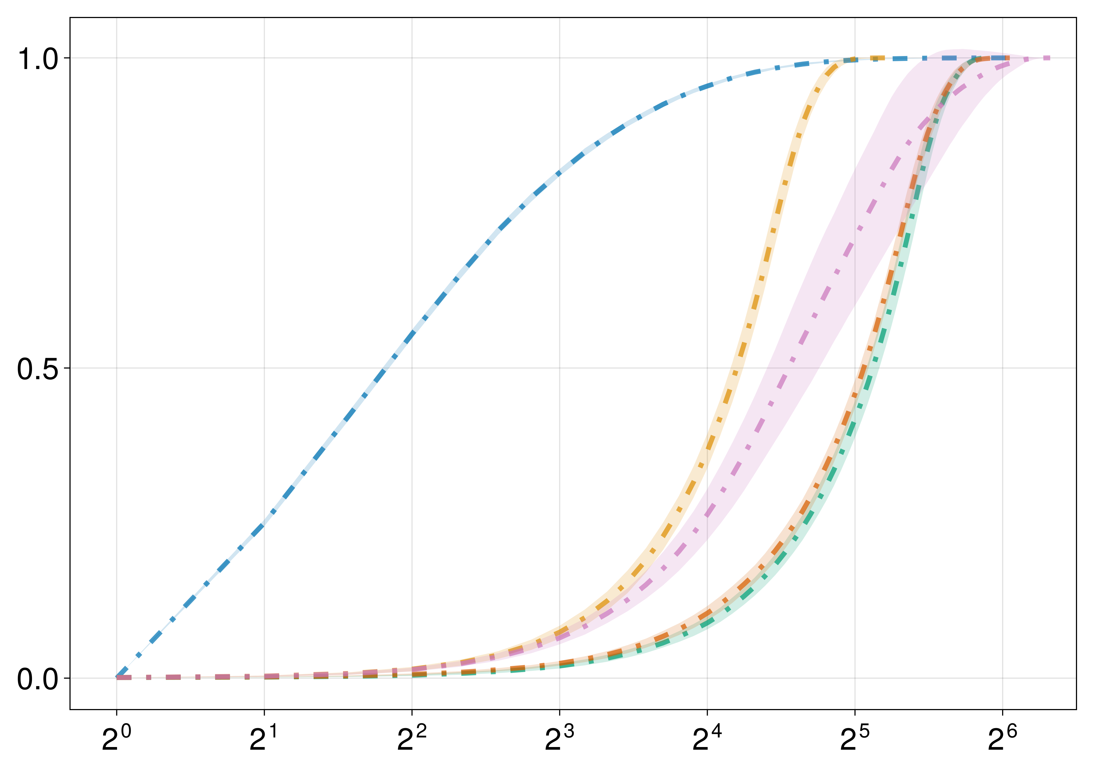
Random
Inner Corner
Traditional
Center
Outer Corner

Slide 11
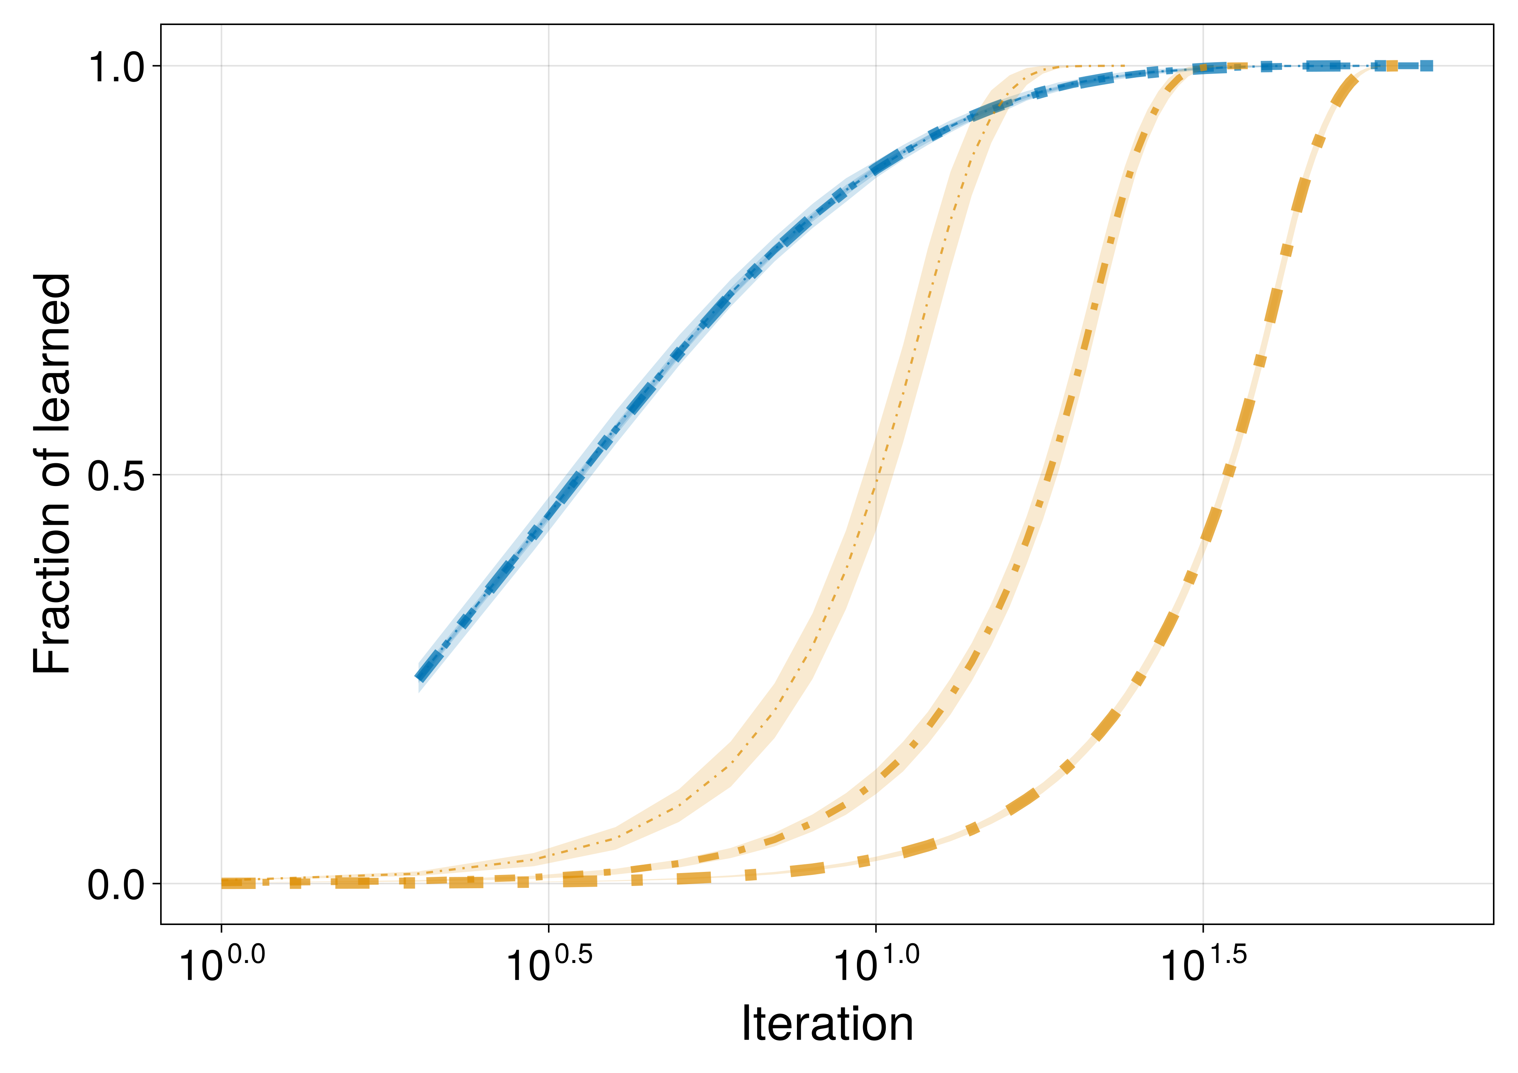
L = 128
L = 32, 64, 128
L = 64
L = 32

Slide 12
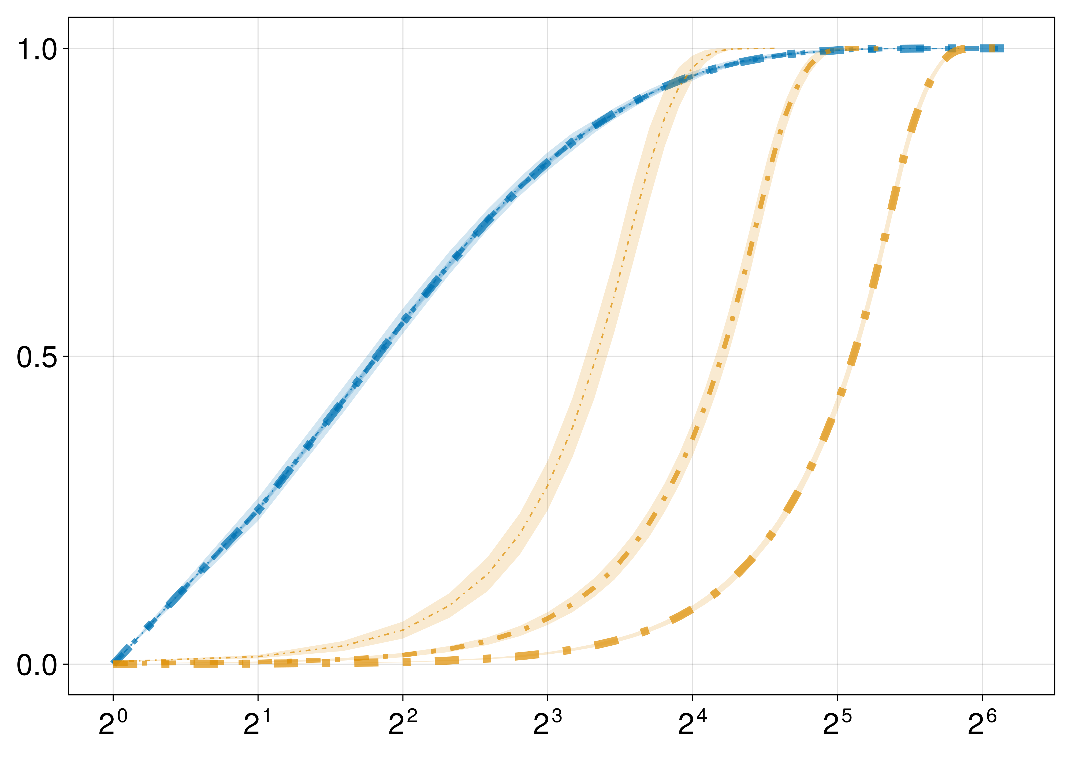
L = 128
L = 32, 64, 128
L = 64
L = 32

Slide 13
(a)
Random
Inner Corner
Traditional
Center
Outer Corner
Fraction of learned
(b)
L = 128
L = 32, 64, 128
L = 64
L = 32
Iteration number

Slide 14
(a)
Random
Inner Corner
Traditional
Center
Outer Corner
Fraction of learned
(b)
L = 128
L = 32, 64, 128
L = 64
L = 32
Iteration number

Slide 15
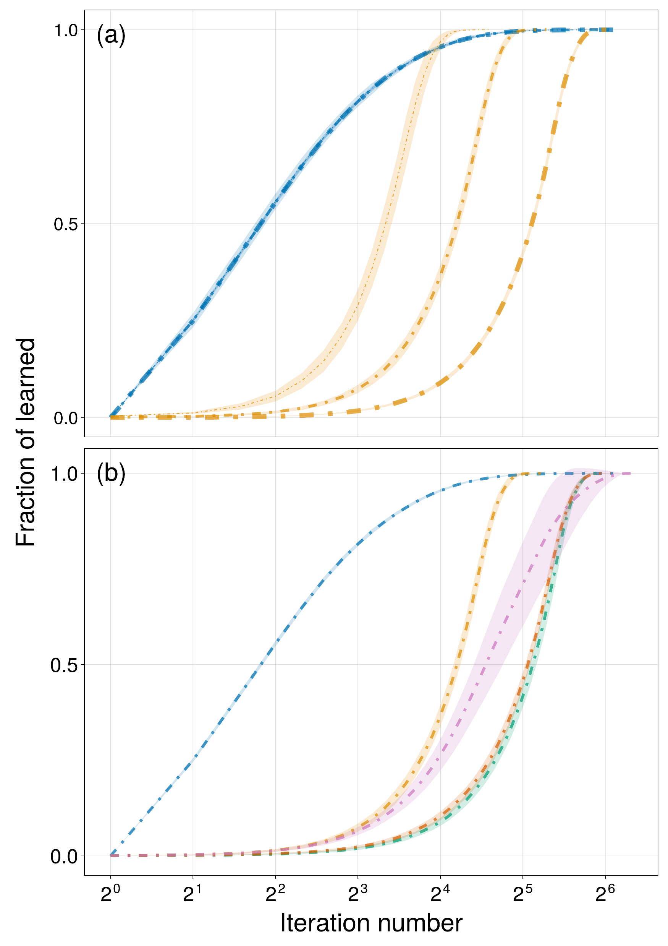
L = 128
L = 32, 64, 128
L = 64
L = 32
Random
Traditional
Center
Inner Corner
Outer Corner

Slide 16

L = 128
L = 32, 64, 128
L = 64
L = 32
Random
Traditional
Center
Inner Corner
Outer Corner

Slide 17
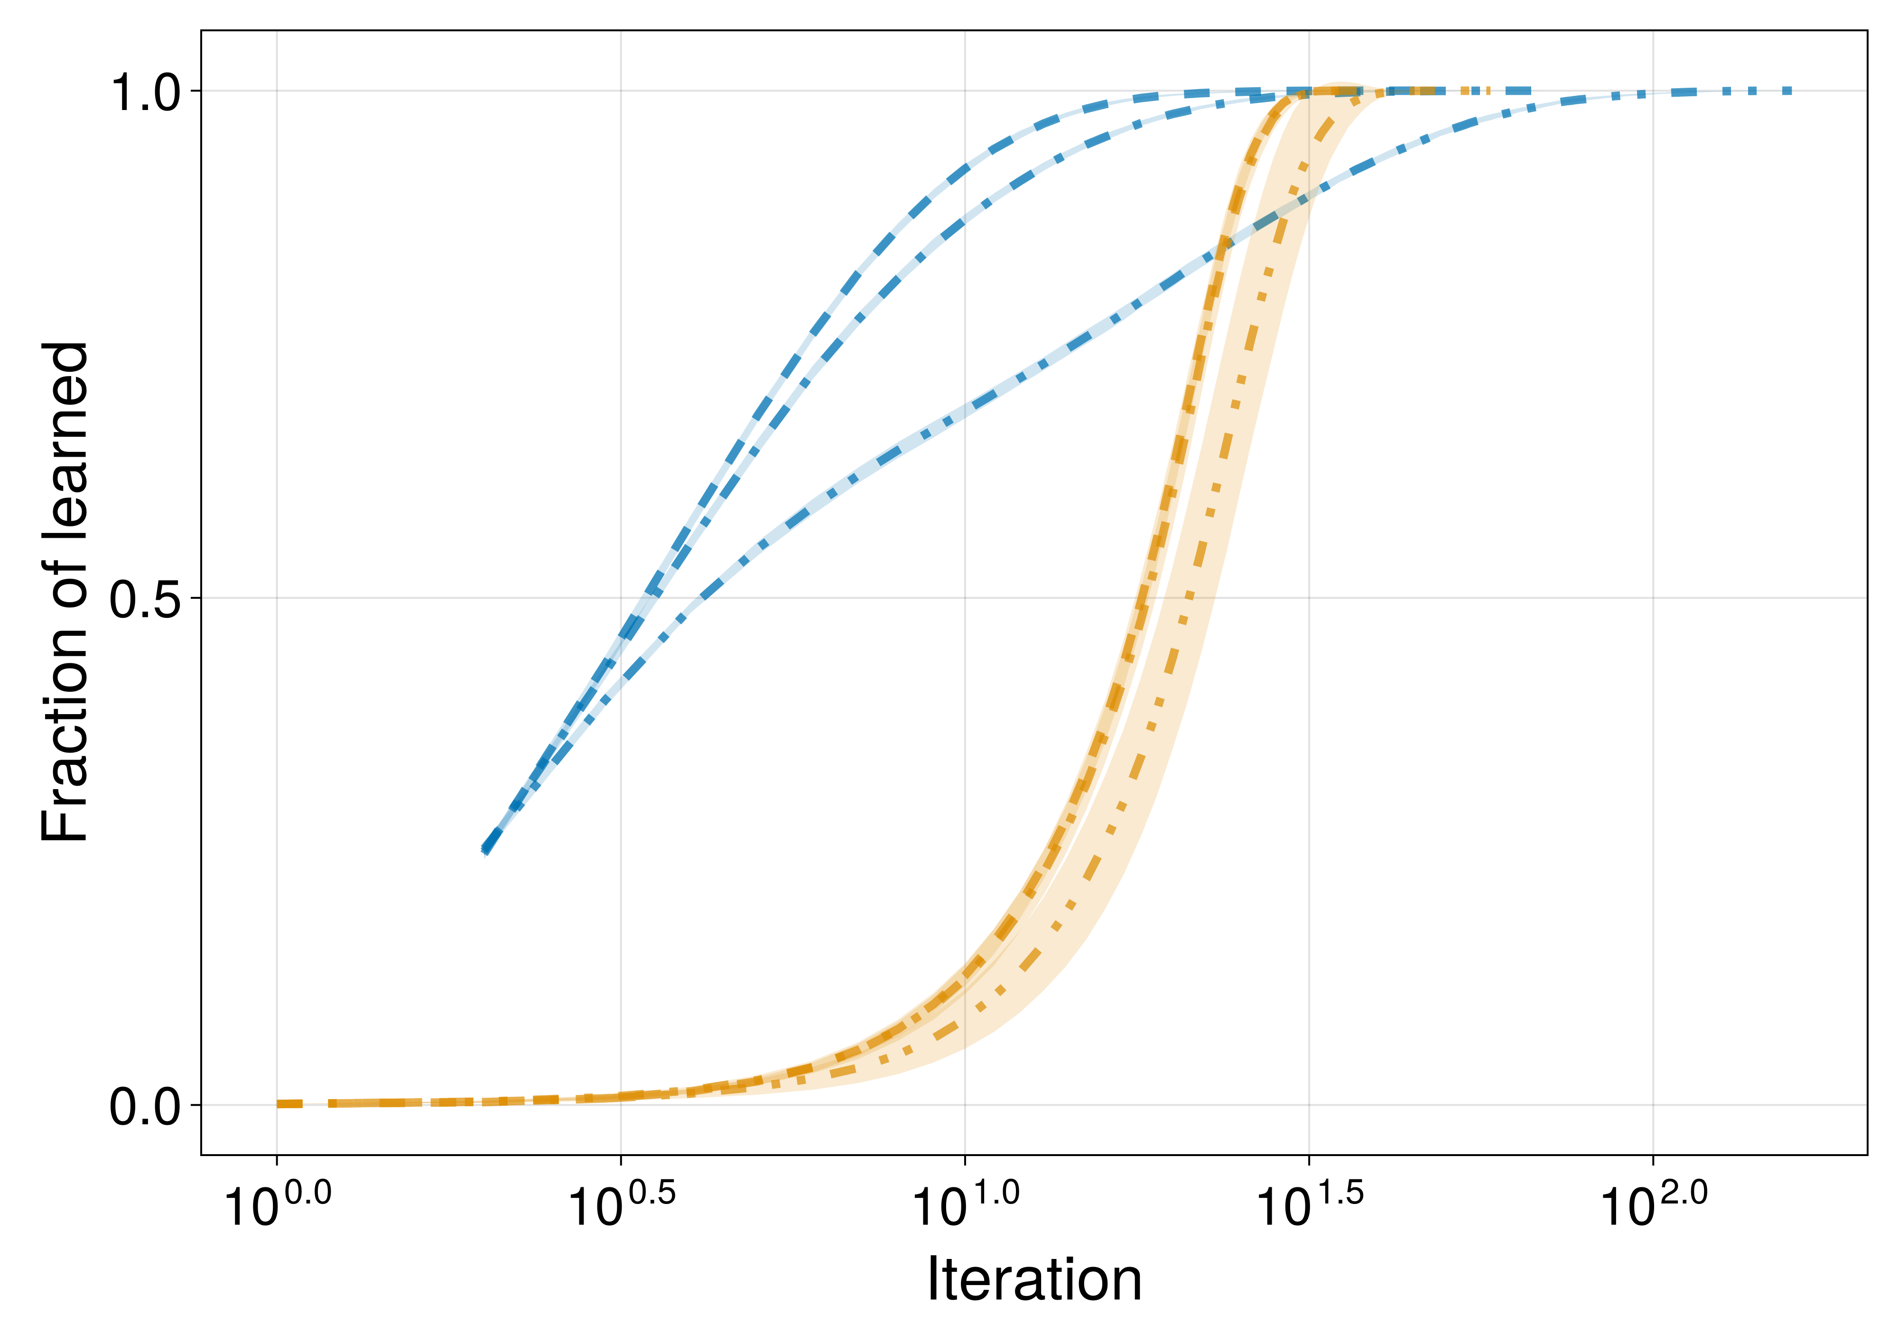
δλ = 0.2
δλ = 0.0
δλ = 0.4
δλ = 0.0, 0.2
δλ = 0.4

Slide 18
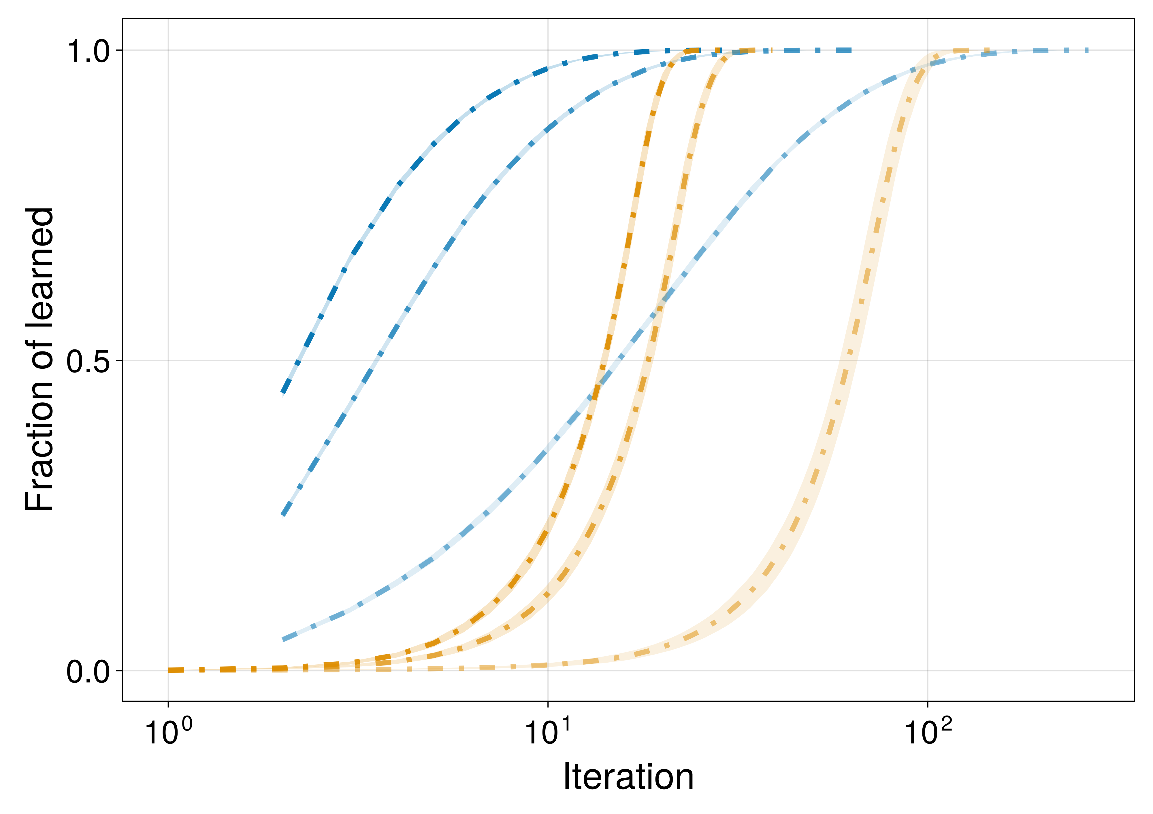
ρ = 0.9
ρ = 0.9
ρ = 0.5
ρ = 0.5
ρ = 0.1
ρ = 0.1

Slide 19
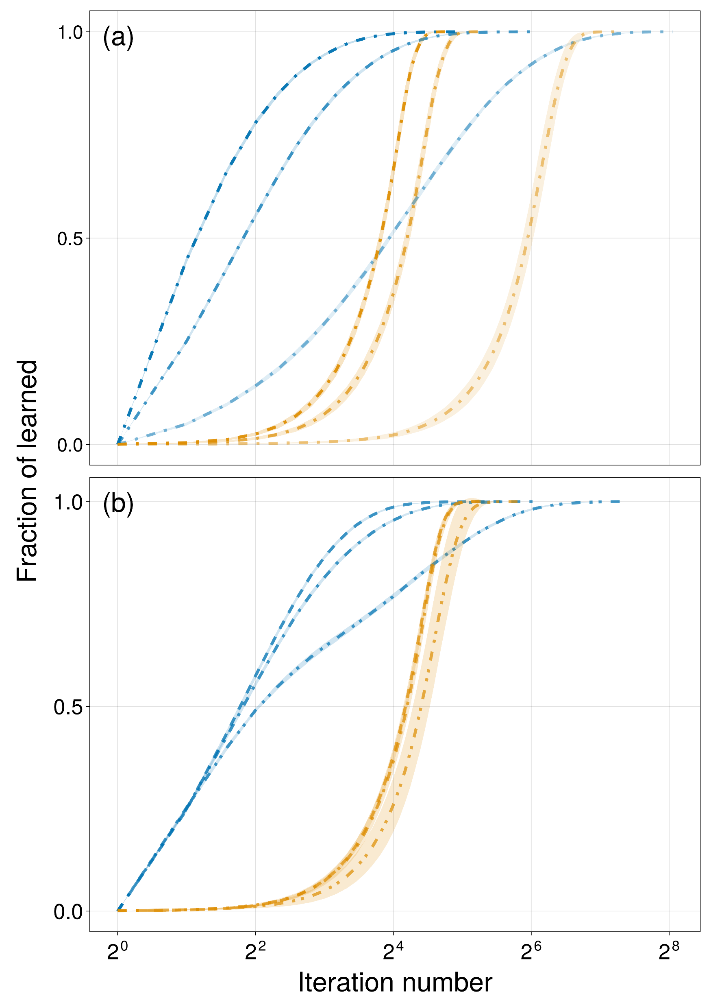
ρ = 0.9
ρ = 0.9
ρ = 0.1
ρ = 0.5
ρ = 0.5
ρ = 0.1
δλ = 0.0
δλ = 0.2
δλ = 0.4
δλ = 0.4
δλ = 0.0, 0.2

Slide 20
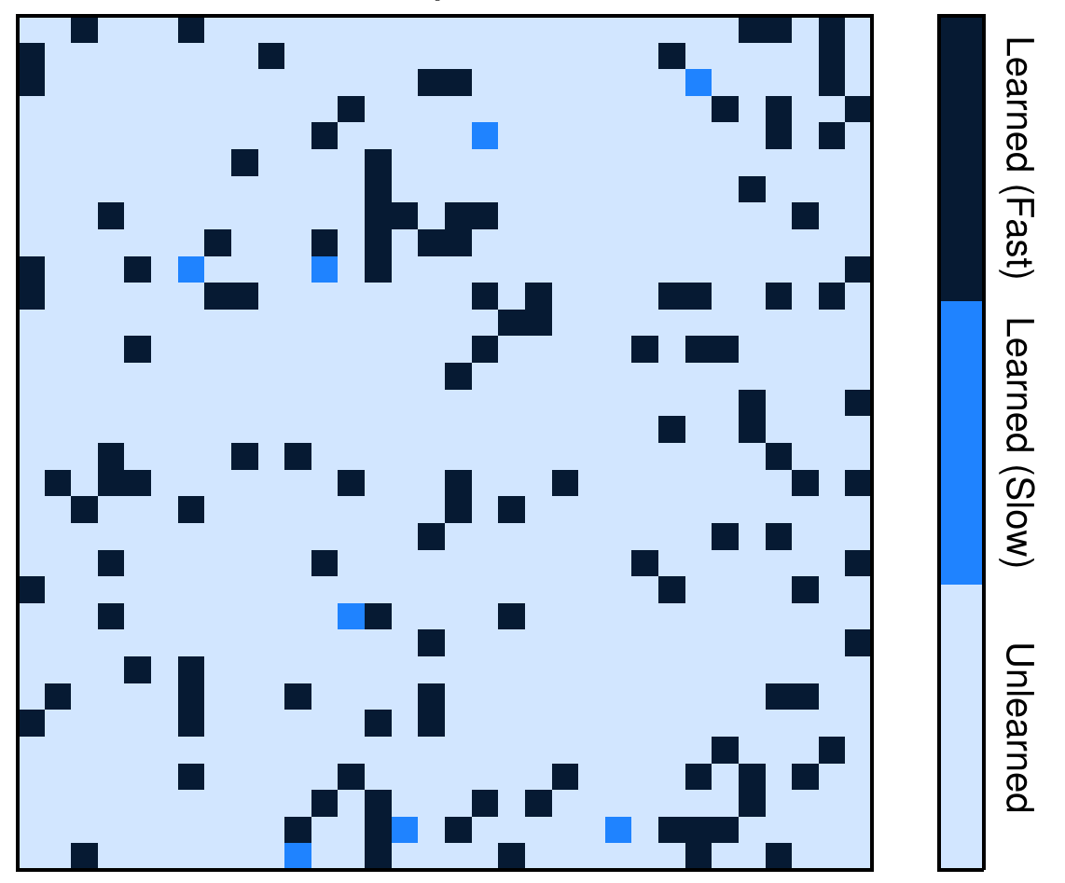
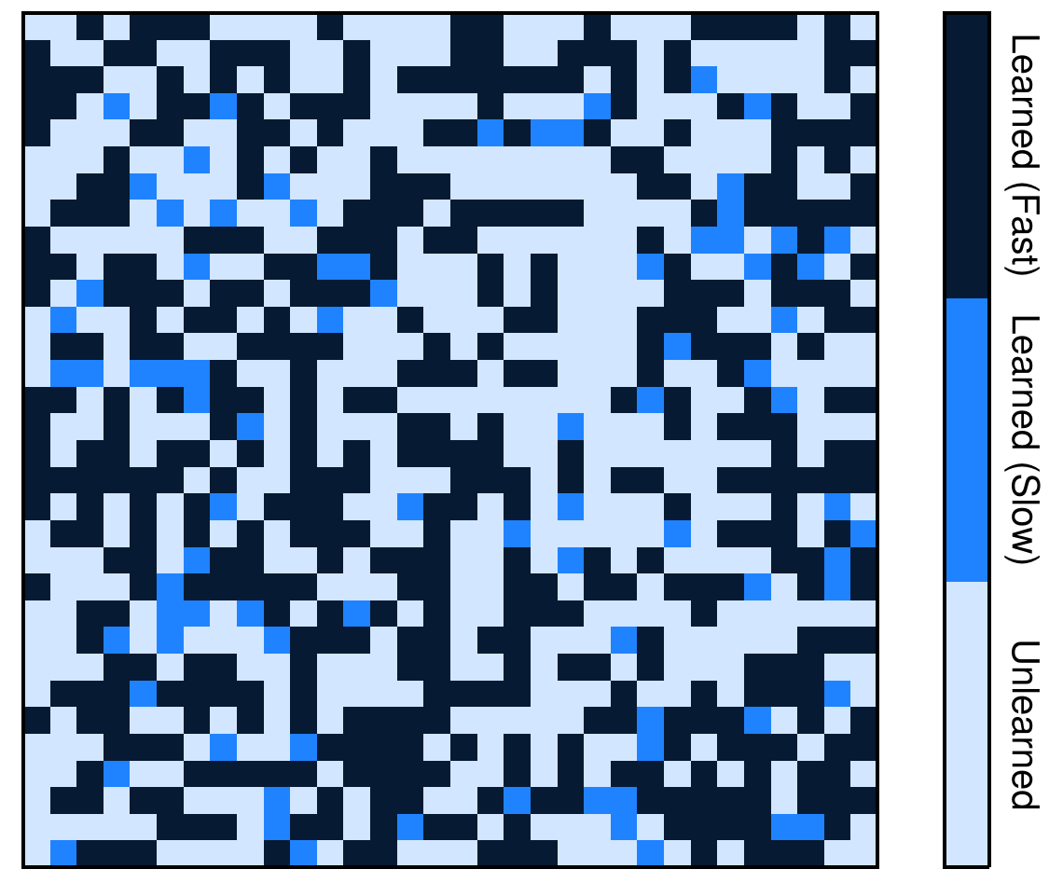
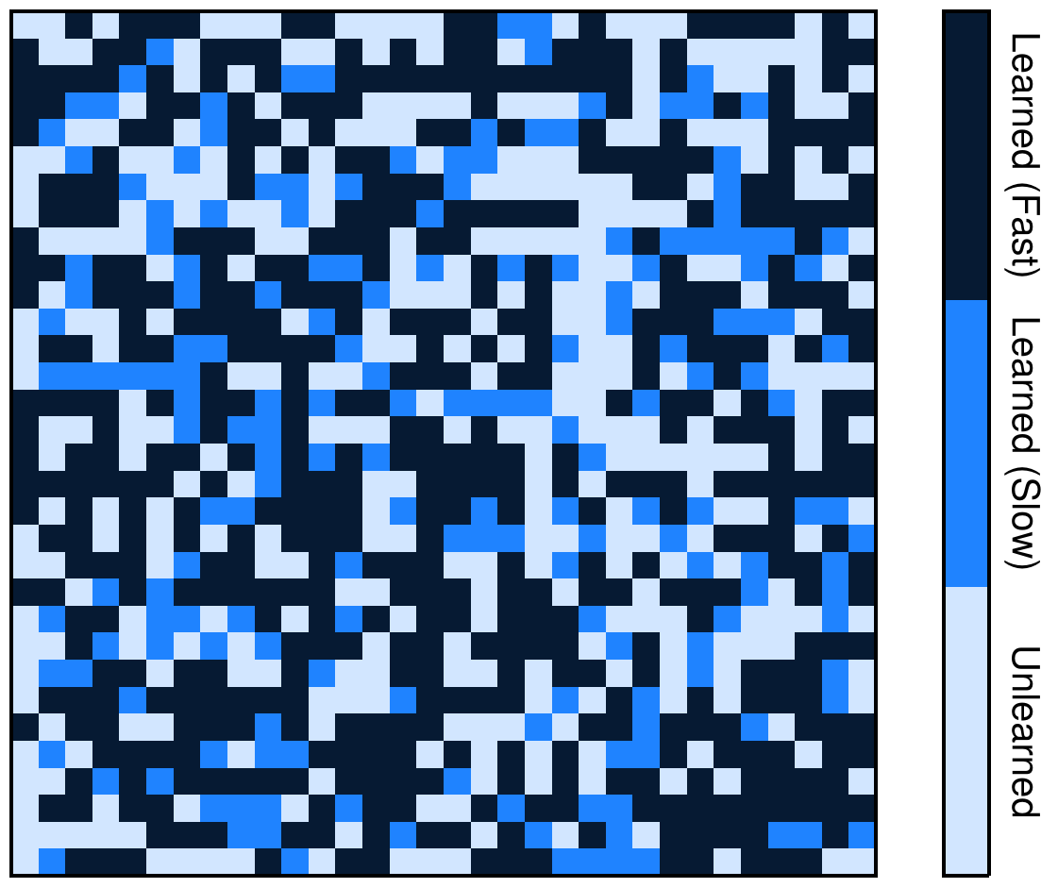
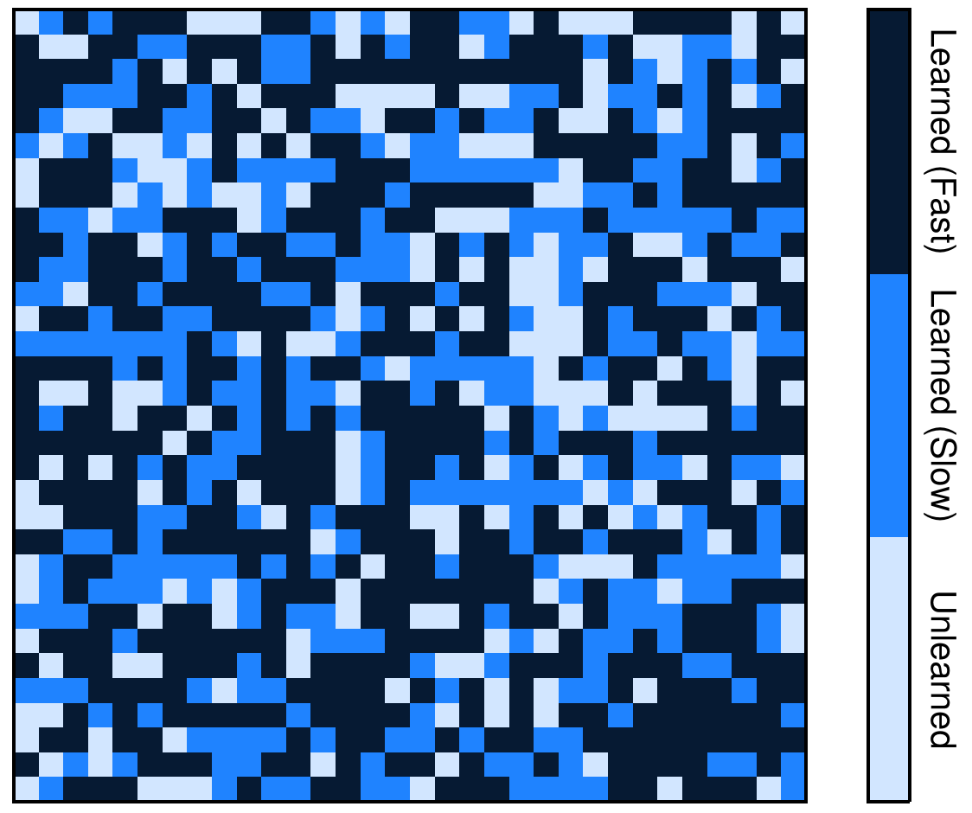
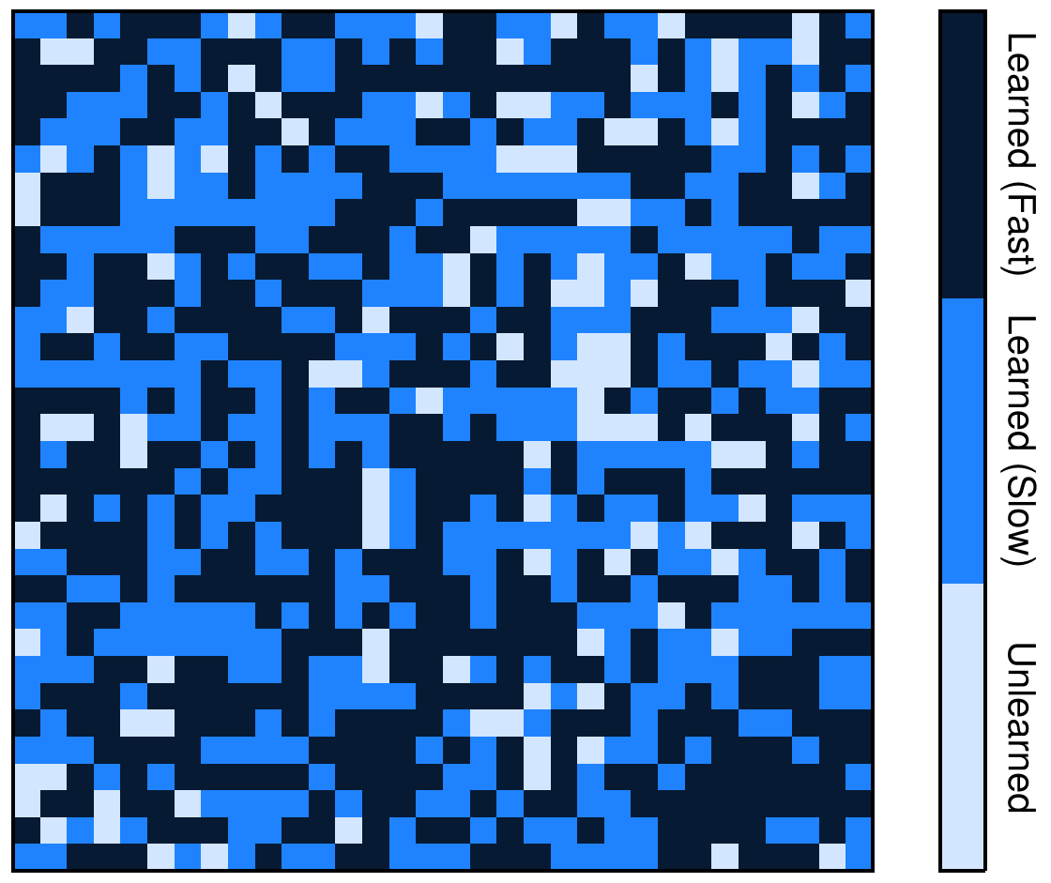
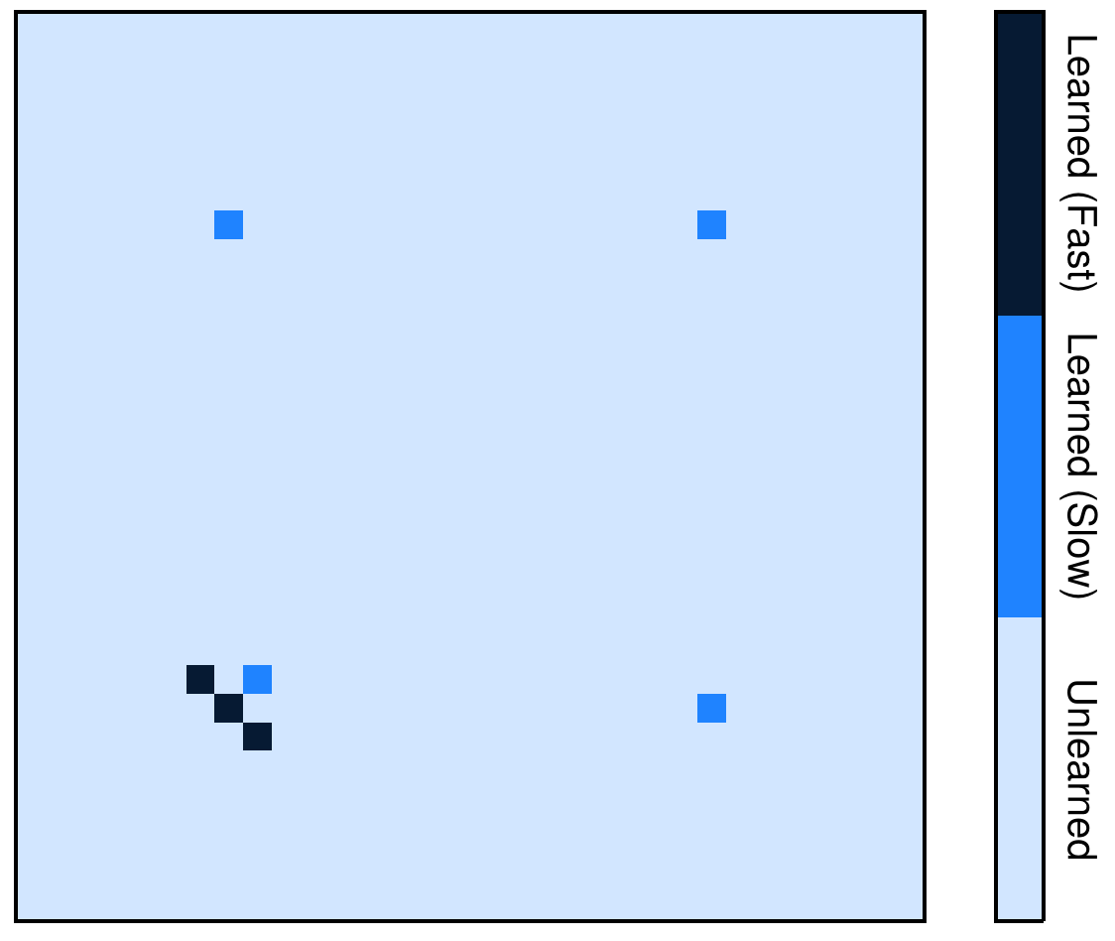
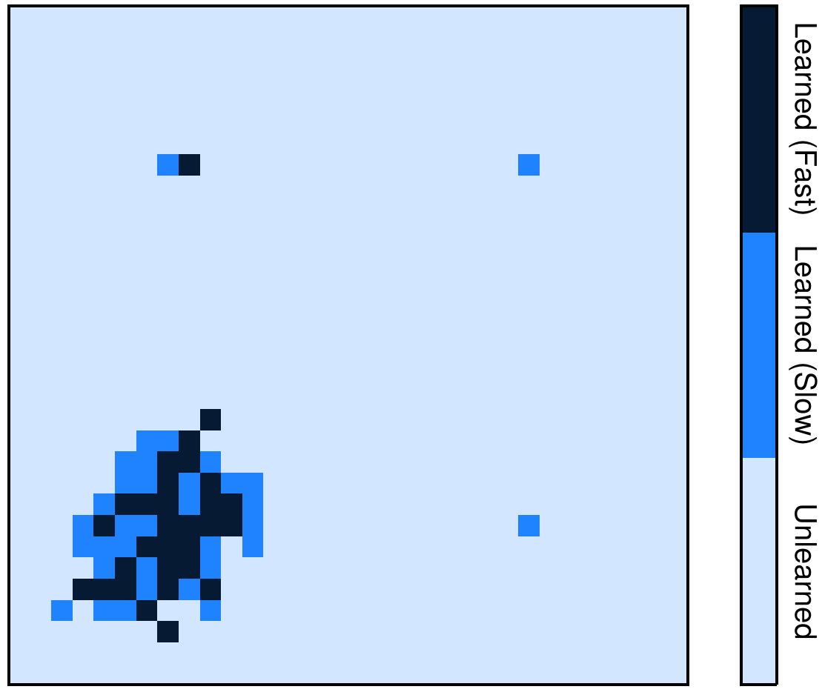
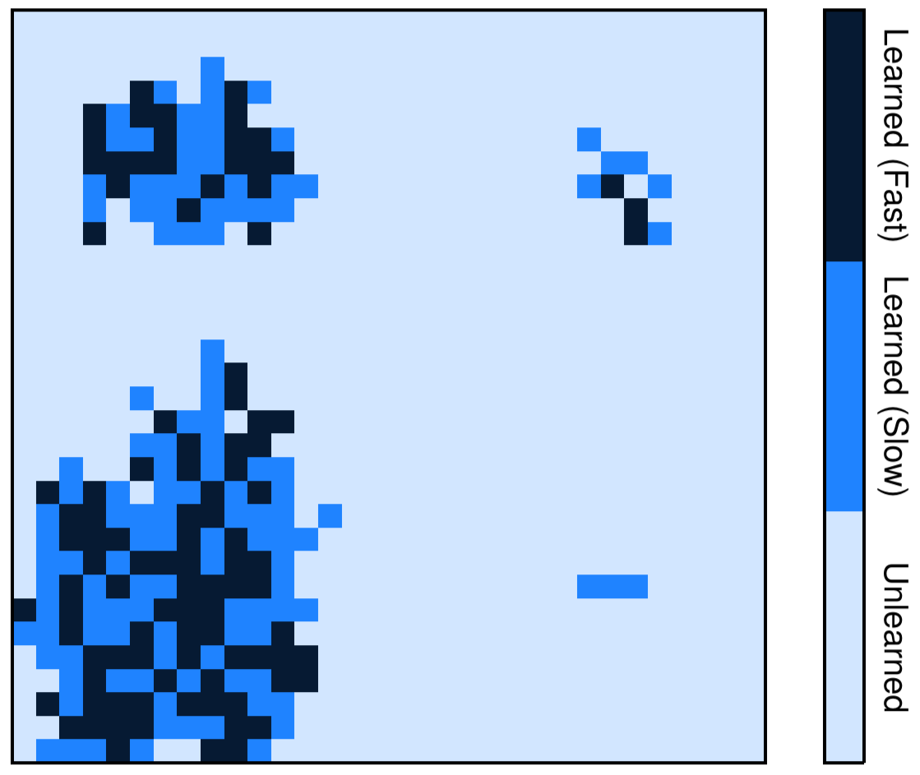
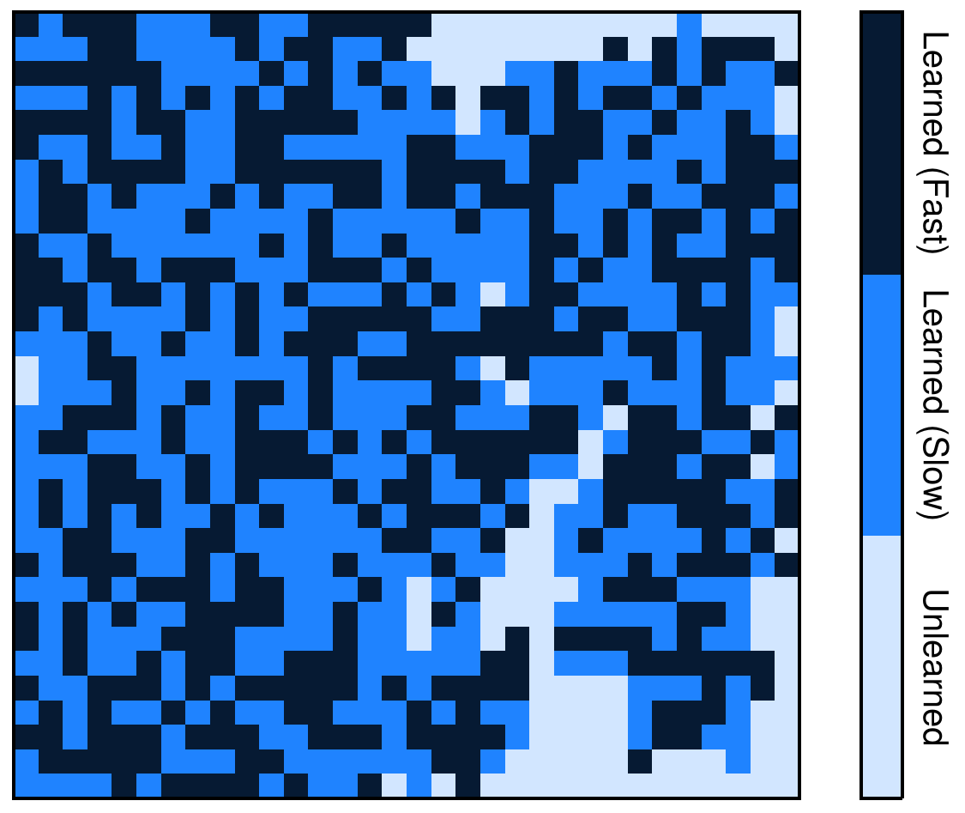
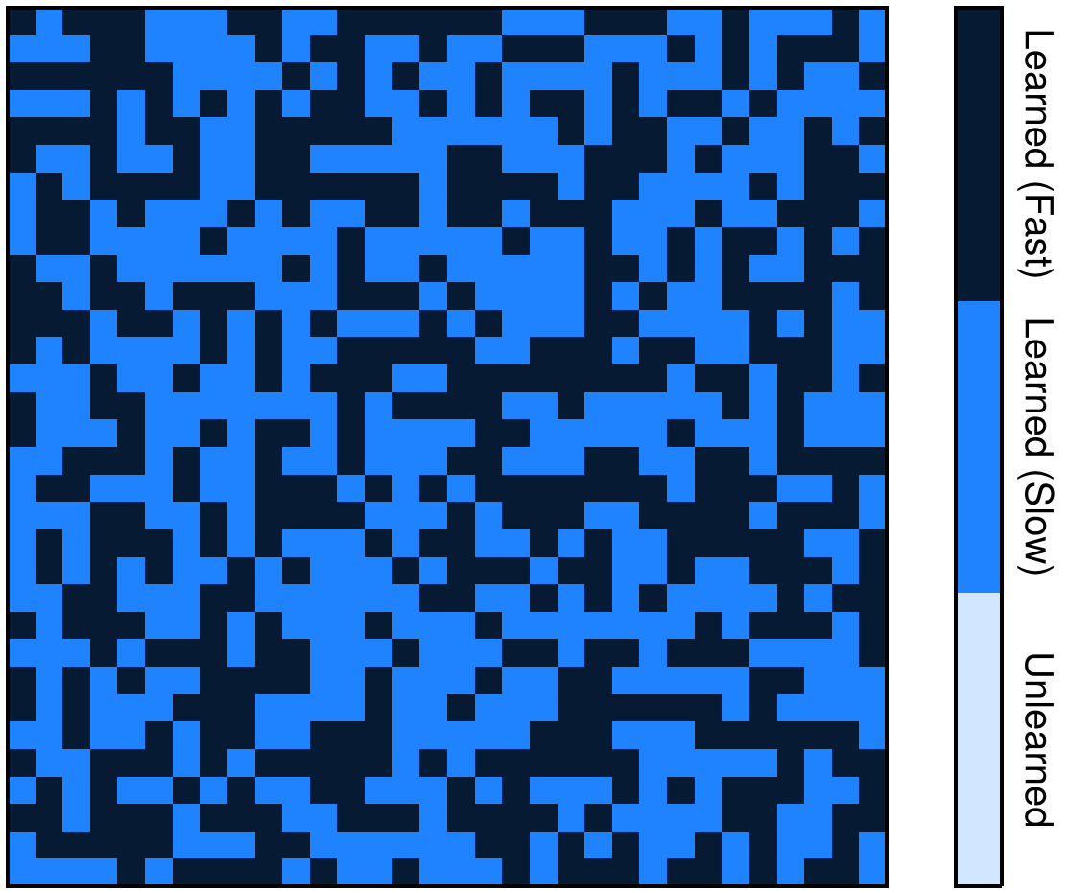







$$t=2$$
$$t=8$$
$$t=16$$
$$t=32$$
$$t=54$$
Traditional
Peer
Unlearned:
Learned:
Slow $(λ=λ_{0}−δλ)$
Fast $(λ=λ_{0}+δλ)$

Slide 21





$$t=2$$
$$t=8$$
$$t=16$$
$$t=32$$
$$t=54$$
Traditional
Peer
Unlearned:
Learned:
Slow
Fast

Slide 22
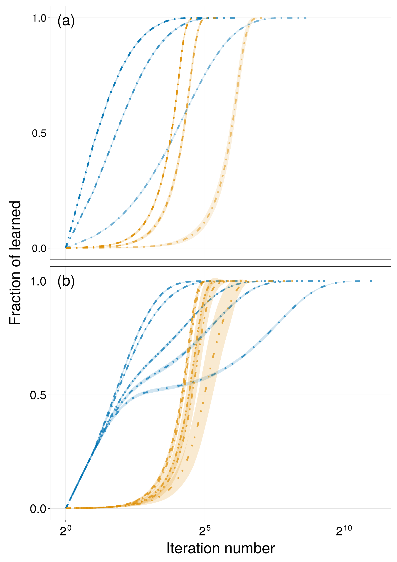
ρ = 0.9
ρ = 0.9
ρ = 0.1
ρ = 0.5
ρ = 0.5
ρ = 0.1
δλ = 0.0, 0.2
δλ = 0.4
δλ = 0.49
δλ = 0.45
δλ = 0.49
δλ = 0.0, 0.2, 0.4, 0.45

Slide 25
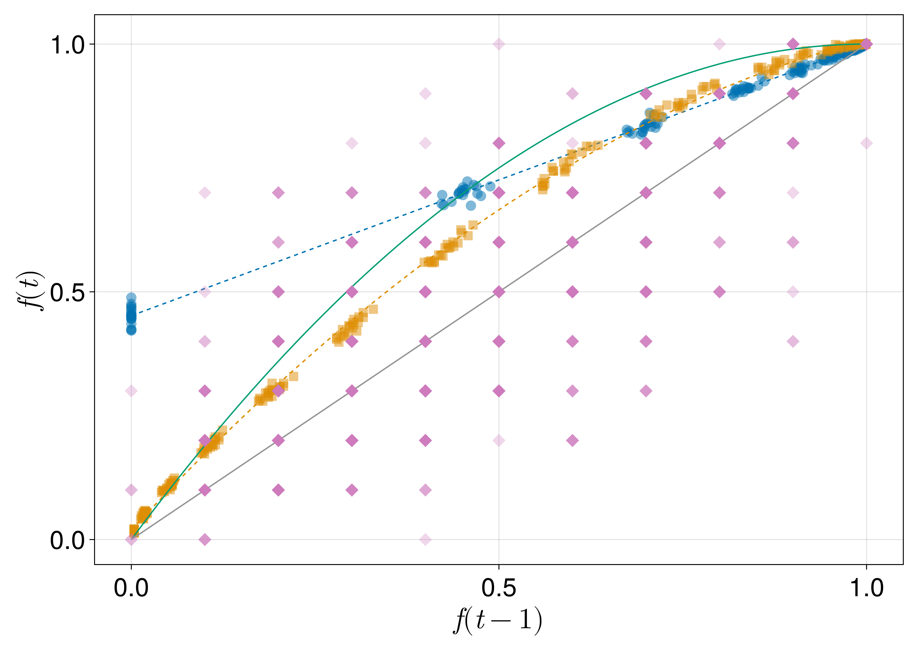



Theoretical (Nitta):
$f_{t}=f_{t−1}+f_{t−1}(1−f_{t−1})$
Traditional:
$f_{t}=0.548 f_{t−1}+0.452$
Peer (inner corner):
$f_{t}=−0.605 f_{t−1}^{2}+1.595 f_{t−1}+0.019$

Slide 26



Theoretical (Nitta):
$f_{t}=f_{t−1}+f_{t−1}(1−f_{t−1})$
Traditional:
$f_{t}=0.548 f_{t−1}+0.452$
Peer (inner corner):
$f_{t}=−0.605 f_{t−1}^{2}+1.595 f_{t−1}+0.019$
Experimental data (Roxas, et. al.)

Slide 27

NM
Theoretical (Nitta):
$f_{t}=f_{t−1}+f_{t−1}(1−f_{t−1})$
TI
Traditional:
$f_{t}=0.548 f_{t−1}+0.452$
Peer (inner corner):
$f_{t}=−0.605 f_{t−1}^{2}+1.595 f_{t−1}+0.019$
PI (IC)
Exp
Experimental data (Roxas, et. al.)

Slide 28



(b) $L=32, ρ_{0}=0.9, λ=0.5±0$
(a) $L=128, ρ_{0}=0.1, δλ=0.5±0.4$
NM
NM
TI
PI (IC)
PI (IC)
Exp
Exp
TI

Slide 29




Theoretical (Nitta):
$f_{t}=f_{t−1}+f_{t−1}(1−f_{t−1})$
Peer (inner corner):
$$f_{t}=−0.033 f_{t−1}^{2}+1.033 f_{t−1}+0.0$$
Traditional:
$f_{t}=0.97 f_{t−1}+0.029$

Slide 30



Theoretical (Nitta):
$f_{t}=f_{t−1}+f_{t−1}(1−f_{t−1})$
Traditional:
$f_{t}=0.97 f_{t−1}+0.029$
Peer (inner corner):
$f_{t}=−0.033 f_{t−1}^{2}+1.033 f_{t−1}+0.0$
Experimental data (Roxas, et. al.)

Slide 31
NM
Theoretical (Nitta):
$f_{t}=f_{t−1}+f_{t−1}(1−f_{t−1})$
Traditional:
$f_{t}=0.97 f_{t−1}+0.029$
PI (IC)
Peer (inner corner):
$f_{t}=−0.033 f_{t−1}^{2}+1.033 f_{t−1}+0.0$
Exp
TI
Experimental data (Roxas, et. al.)

Slide 32


(a) L = 32
(b) L = 128
Traditional
Peer

Slide 33


(a) L = 32
Traditional
Peer
(b) L = 128

Slide 34

L = 128
L = 32, 64, 128
ρ = 0.9
ρ = 0.9
ρ = 0.1
L = 64
L = 32
ρ = 0.5
ρ = 0.5
ρ = 0.1
δλ = 0.0, 0.2
δλ = 0.4
Random
δλ = 0.49
δλ = 0.45
Traditional
δλ = 0.49
Center
Inner Corner
δλ = 0.0, 0.2, 0.4, 0.45
Outer Corner

